Slide 1
Evaluation of a Prototype, Triple-Tube, Water-based Nano Spot-Collector: Application to Microscopic and Spectroscopic Analysis of Aerosols
Presenter: Orthodoxia Zervaki
Authors: Orthodoxia Zervaki ^{a, b}, Braden Stump ^{c}, Patricia Keady ^{c}, Pramod Kulkarni ª, Dionysios D. Dionysiou ^{b}
ª Centers for Disease Control and Prevention, National Institute for Occupational Safety and Health, Cincinnati, OH, USA
^{b} Environmental Engineering and Science Program, Department of Chemical and Environmental Engineering (ChEE), University of Cincinnati, Cincinnati, Ohio 45221, United States
^{c} Aerosol Devices Inc, Fort Collins, CO 80524, USA
ACS Conference San Diego, 20-24 March 2022
Notes:
Hello. My name is Orthodoxia Zervaki and here, I’m going to present to you the “Design and Characterization of a Triple-tube, Laminar-Flow Condensation Nano Spot Collector” and its application to microscopy and spectroscopic analysis of aerosols. But before that let me tell you some information about me. I am a graduate student at the University of Cincinnati. Additionally, I am conducting my research in the National Institute for Occupational Safety and Health of CDC, at Cincinnati.

Slide 2
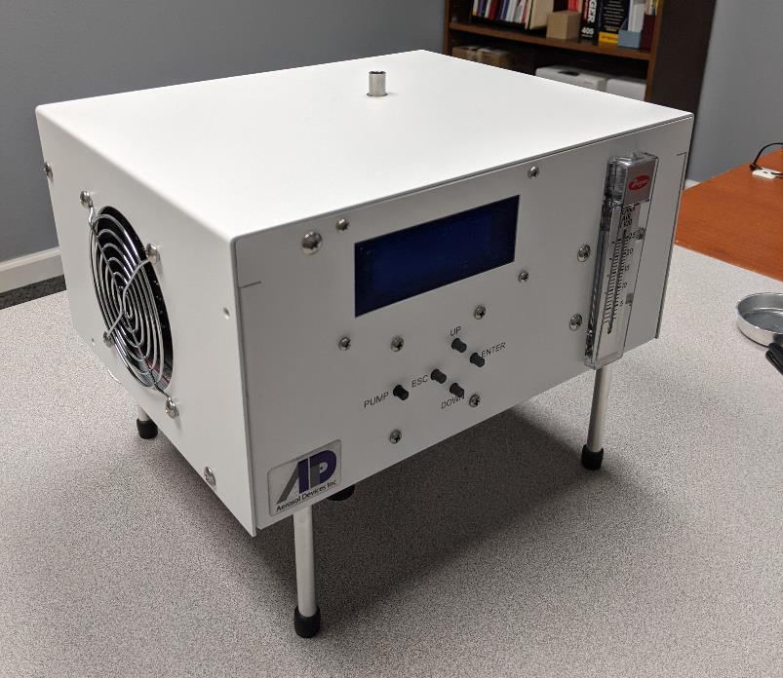
Objective
Evaluation of an ADI’s prototype Nano Spot-Collector, coupled with direct electron or optical microscopy, and laser spectroscopic analysis of nanoparticles and aerosols.
Water-based, laminar-flow condensation particle growth technique
High aerosol sample flowrate (1.2 L min⁻¹)
Direct spot sample analysis using Scanning Electron Microscopy (SEM)/ Transmission Electron Microscopy (TEM) and laser spectroscopy
Suitable for a wide variety of chemical constituents and microorganism collection
Prototype Nano Spot Collector (NSC)
Notes:
First, let me start with the objective of the presented research. Here, I am going to describe performance evaluation of a prototype aerosol Nano-Spot Collector, built from the Aerosol Devices Inc., designed for direct electron or optical microscopy, and laser spectroscopic analysis of nanoparticles and aerosols. The nano-spot collector implements the popular, water-based, condensation technology.
The moderated three-stage growth tube consist of 3 temperature regions for controlling the vapor profile. The droplet growth in the nano-spot collector occurs at temperatures close to ambient, that renders this instrument suitable for collection of not only a variety of chemical constituents but for microorganism collection too.

Slide 3
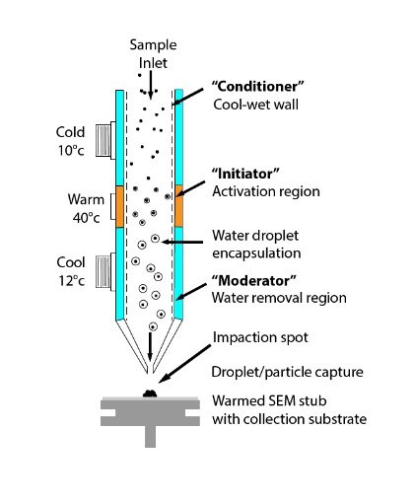
Nano-spot Collector’s Operation
Cold
5 °C
Stage 1, “cold”: Aerosol stream exposure to a cold, water vapor-saturated environment
Stage 2, “warm”: Saturated aerosol stream flows through a heated stage; generation of supersaturation
Stage 3, “cold”: Droplet-laden flow’s dew point and vapor content reduction
Warm
45 °C
Cool
12 °C
Schematic of the growth tube with particle collection on an SEM stub ⁽¹⁾.
Notes:
The moderated three-stage growth tube consist of 3 temperature regions for controlling the vapor profile. Stage 2: Saturated aerosol stream flows through a heated stage; supersaturation is generated, where the water vapor diffusion rate is higher than the heat dissipation rate; thus, water vapor is condensed on the particles, and droplet growth occurs. During the last stage, lower temperature is employed with the scope of reducing the flow’s dew point and vapor content, for hindering subsequent vapor condensation on surfaces, while droplet growth progresses.
The droplet growth in the nano-spot collector occurs at temperatures close to ambient, that renders this instrument suitable for collection of not only a variety of chemical constituents but for microorganism collection too.

Slide 4
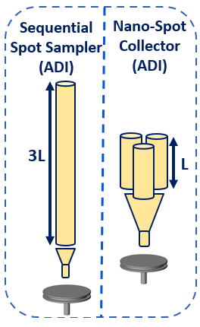
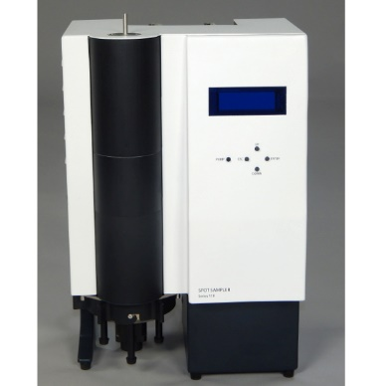
Sequential Spot Sampler (ADI) vs Nano-spot Collector (ADI)
Sequential Spot Sampler (ADI)
Prototype Nano Spot Collector (ADI)
Table 1 Design and operating parameters of the Sequential Spot Sampler and the Nano-spot Collector
 | Sequential Spot Sampler (Aerosol Devices Inc.) | Nano-spot Collector (Aerosol Devices Inc.)
Height × Width × Depth (mm) | 500 × 305 × 255 | 250 × 280 × 290
Weight (kg) | 7.9 | 4.08
Sample flowrate (L min⁻¹) | 1.0-1.5 | 1.2
Schematics of the single and the triple growth tube contained in the Spot Sampler and the Nano-spot Collector ⁽¹⁾
Notes:
So, how is the Nano-spot collector different from other Condensational growth collectors?
First and foremost, three growth tubes are used, instead of one, for minimizing the instrument’s height and maximizing its flowrate. The dimensions of the collector are 10 by 11 by 11.5 inches, and its weight does not exceed the 9 pounds. Additionally, the water-encapsulated particles impact onto the warmed surface of an SEM stub or a TEM grid, where the water evaporates and leaves a dry spot of particles, smaller than 1 mm.

Slide 5
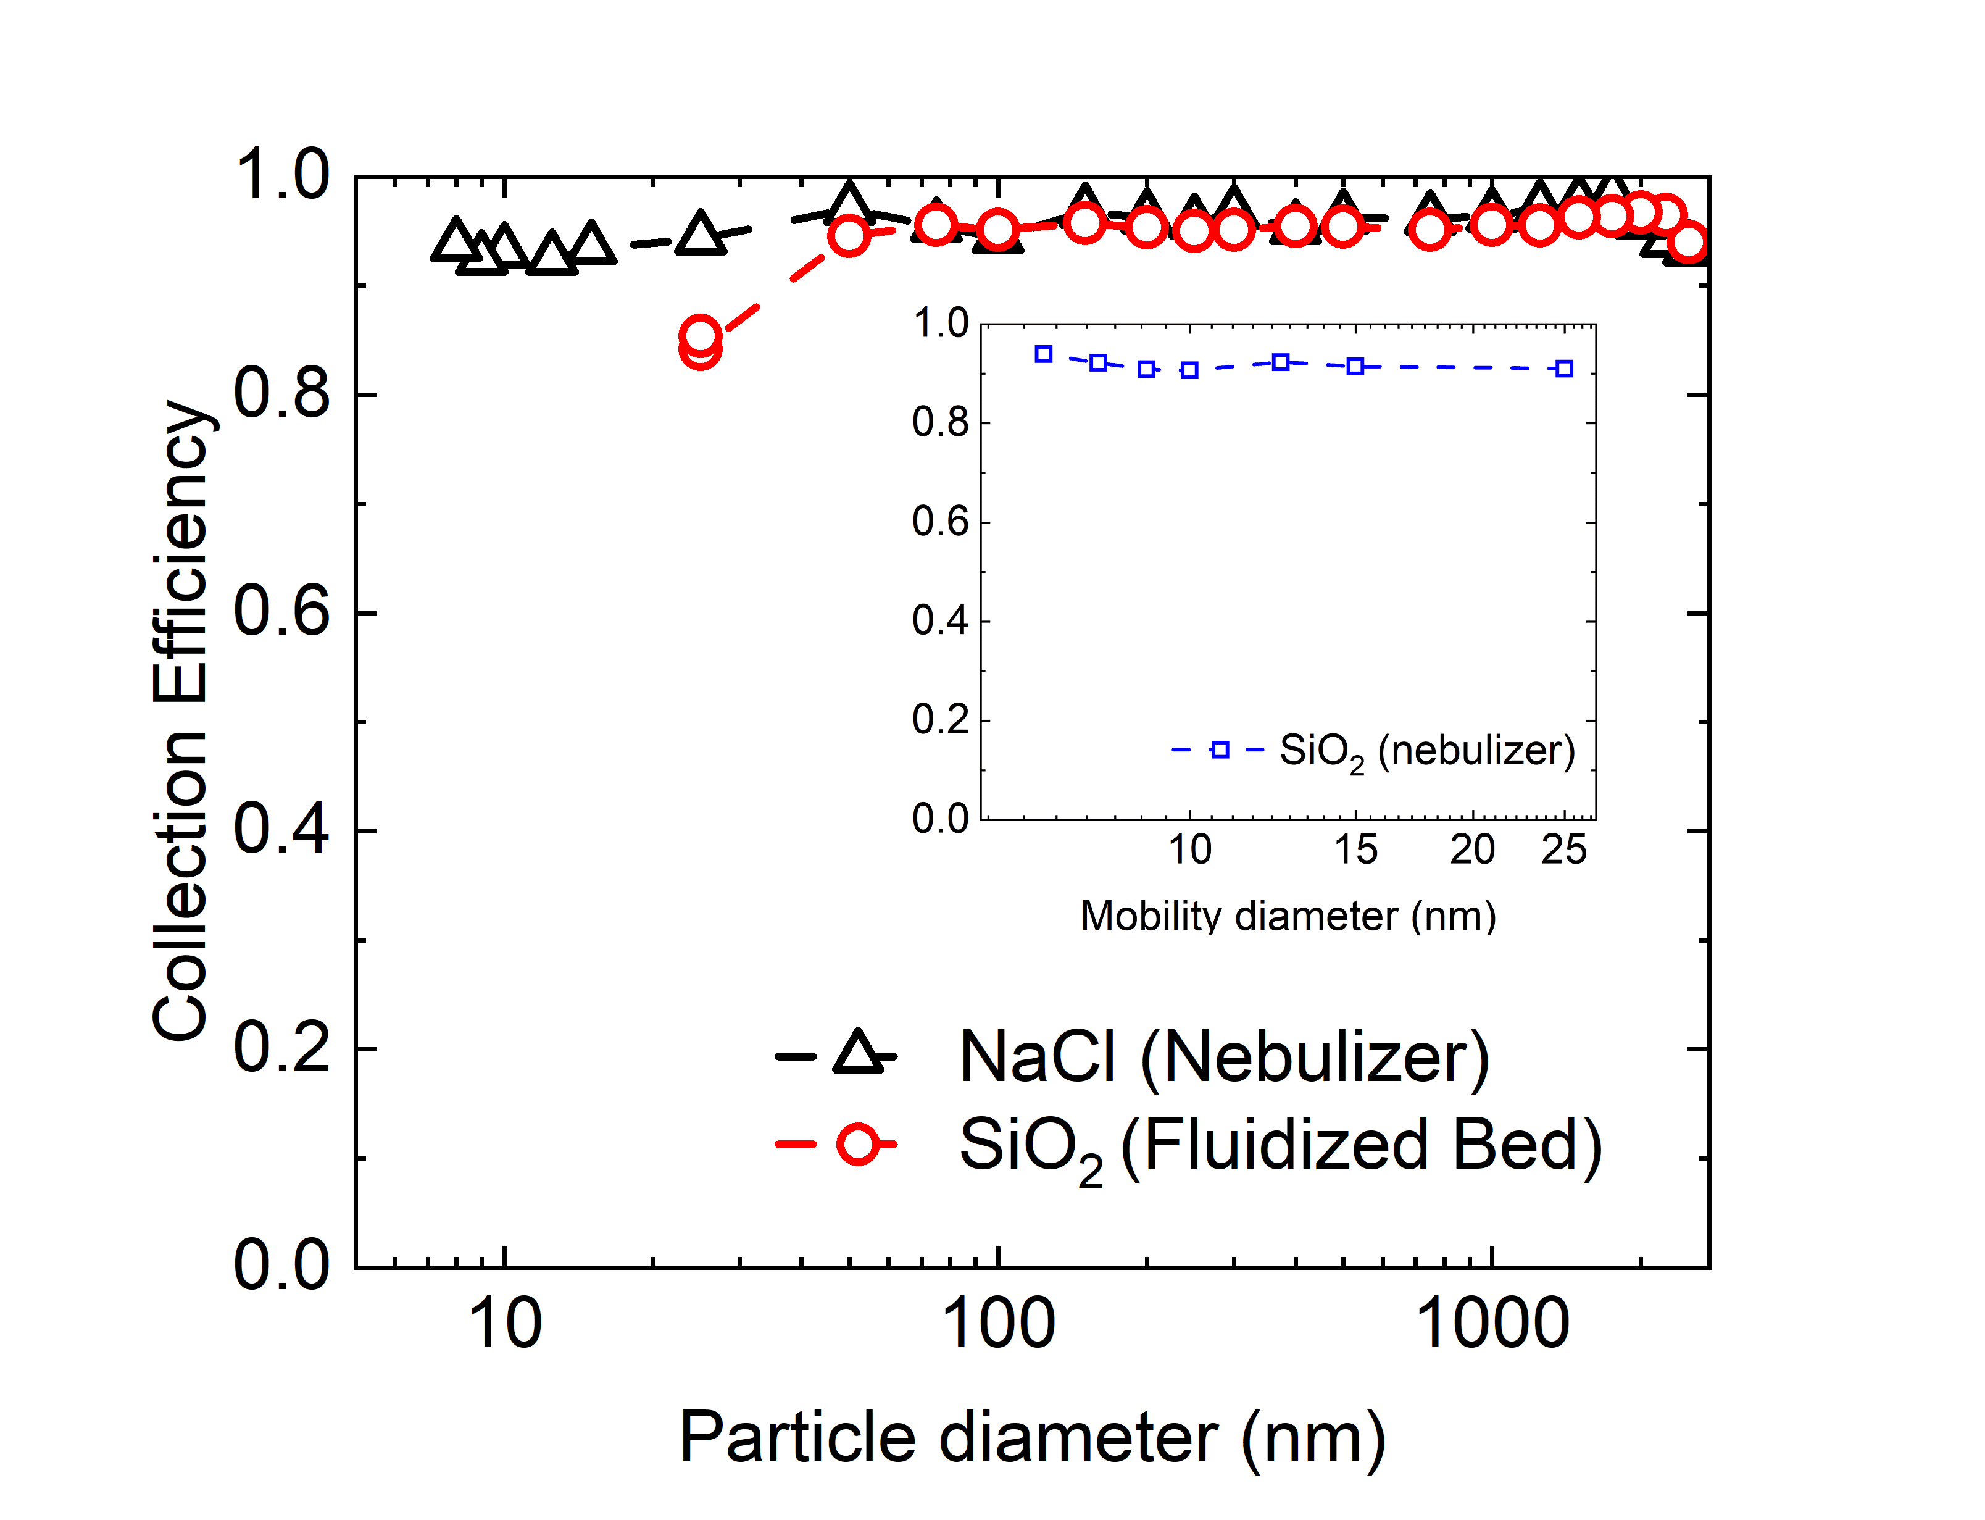
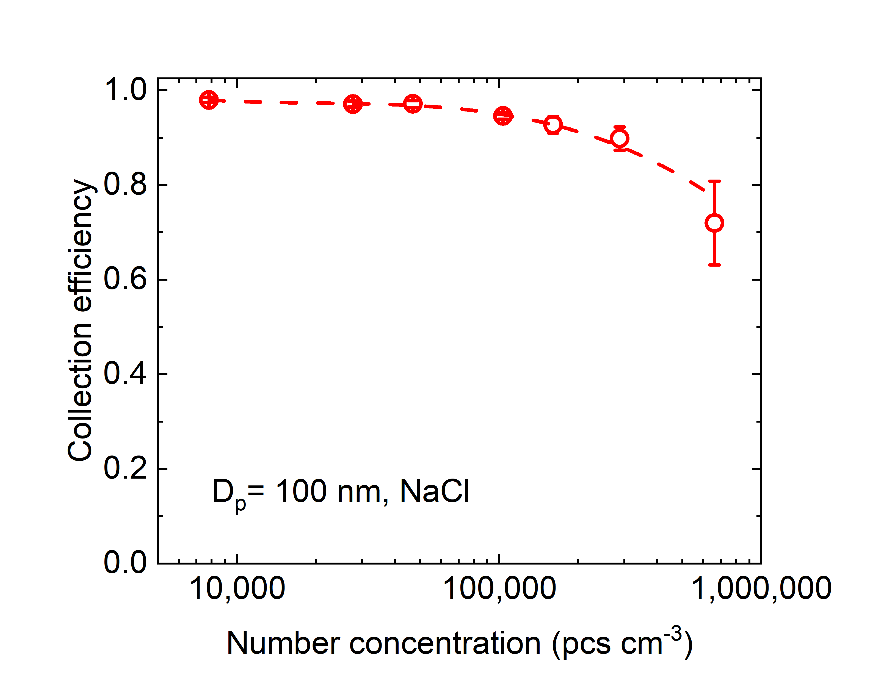
Collection Efficiency vs…
…Particle Size … Aerosol Concentration
Figure 1 Collection efficiency of prototype Nano-spot Collector using sodium chloride and crystalline silica, in function with the aerosols’ particle size.
Figure 2 Collection efficiency of prototype Nano-spot collector in function with the aerosols number concentration.
Notes:
The characterization of the nano spot collector started by measuring the collection efficiency in function with the particle diameter, for 2 different initiator temperatures, 40 and 45 degrees of Celsius. Sodium chloride and silica were used as aerosols of interest. Humidified silica particles were collected down to 9 nm. Collection efficiency of silica powder was complete down to 50 nm but starts decreasing at 25 nm.
More than 95 percent of sodium chloride was collected for sizes down to 10 nm, at a higher initiator temperature, while at a lower initiator temperature, the collection cut point size is at 9.5 nm.

Slide 6
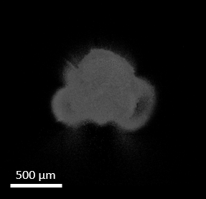
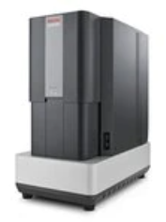
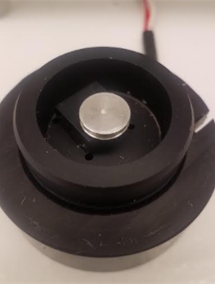
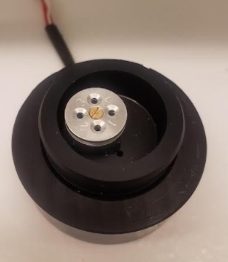
Direct Analysis of Spot Sample
Electron Microscopy
Scanning Electron Microscopy (SEM)
Transmission Electron Microscopy (TEM), etc.
SEM image of accumulated silica
PhenomTM XL G2 Desktop SEM, Thermo Fisher Scientific, Waltham, MA, USA
SEM stub
TEM grid holder
Notes:
The number concentration effect on the nano-spot collector was tested. Here, the collection efficiency of sodium chloride particles with a diameter of 100 nm, is plotted against the particle’s number concentration. Three different initiator/moderator temperature sets were examined. The poorest performance was observed at the lowest initiator temperature, as expected. A significant improvement is observed at a higher initiator temperature, as the vapor content in the growth tube increases. Higher moderator temperature did not show any significant improvement of the collection efficiency at greater concentrations.

Slide 7
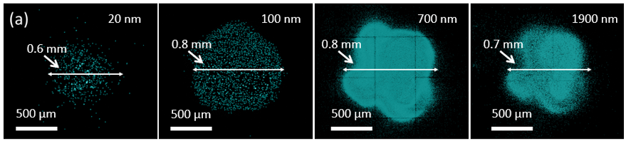
Scanning Electron Microscopy (SEM): Deposit Diameter
Figure 3 SEM images of the deposition spot formed by Polystyrene Latex (PSL; (Thermo Fisher Scientific, Waltham MA, USA) particles of 20 nm, 100 nm, 700 nm, and 1,900 nm size
Deposit diameter measured → D₉₀ = 0.7 mm
Notes:
The deposition diameter of PSL spheres with four different diameters, was calculated. Nano and micro spheres of 20, 100, 700 and 1900 nm PSL particles were used. The initiator temperature was set at 40 degrees of Celsius.
By implementing ImageJ, a software for particle counting, the diameter of the deposition area formed was calculated, and was found to be among 0.6 to 0.8 mm for all PSL sizes.

Slide 8
Direct Analysis of Spot Sample
Electron Microscopy
Scanning Electron Microscopy (SEM)
Transmission Electron Microscopy (TEM), etc.
Laser Spectroscopic Analysis
Raman Spectroscopy
Infrared (IR) Spectroscopy, etc.
Notes:
The nano-spot collector can be coupled with several analysis techniques, such as Raman spectroscopy that was implemented in this study.

Slide 9
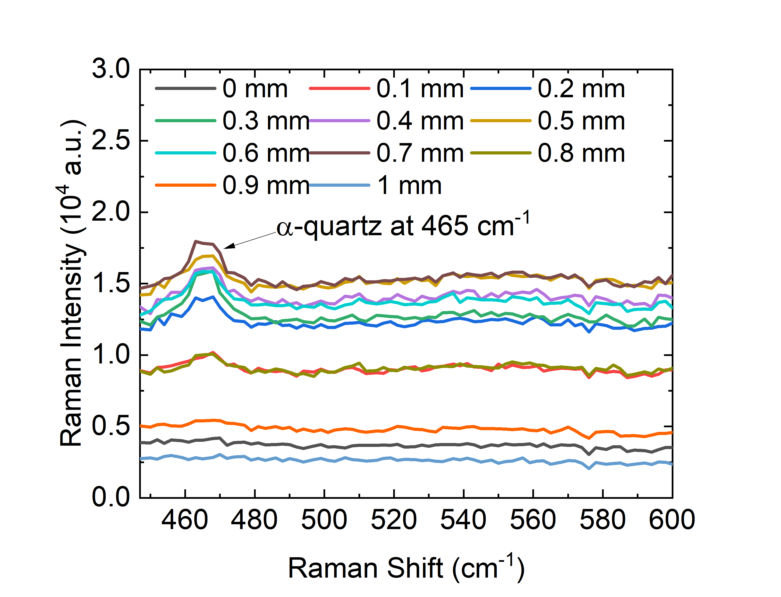
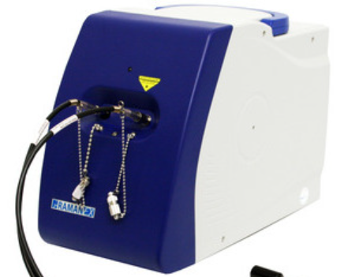
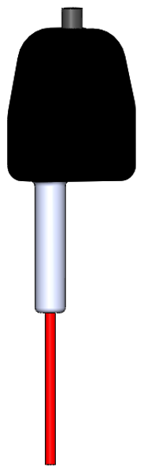
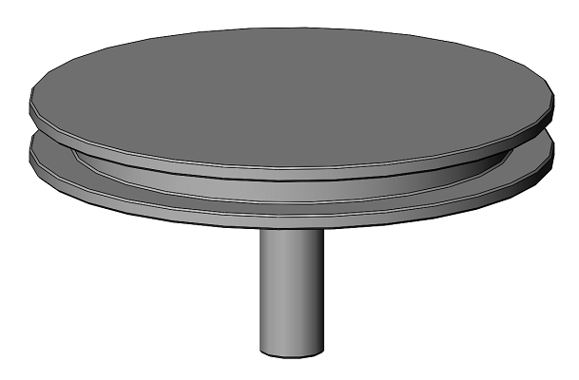
Raman Spectroscopy
(a)
Raman probe
(b)
i-Raman B&W Tek, Newark, DE, USA
Sample
SEM stub
Excitation wavelength: 785 nm Laser power: 420 mW
Working distance: 9 mm
Laser beam diameter: 105 μm
Integration time: 30 s
Figure 4 Raman spectra obtained during (a) deposition uniformity evaluation and (b) the mass calibration curve extraction
Notes:
The nano-spot collector can be coupled with several analysis techniques, such as Raman spectroscopy that was implemented in this study.

Slide 10
Raman Spectroscopy: Deposit Uniformity
Particulate mass of 1.3 μg Min-U-Sil@5
D
(a)
Figure 5 (a) SEM mapping image of deposited silica sample. (b) Raman Intensity signal obtained in function with the Raman sampling location, for four different sampling paths, depicted on image (a) ⁽¹⁾.
Raman intensity is more uniform in the specified location range (D=0.4 mm).
Notes:
The nano-spot collector can be coupled with several analysis techniques, such as Raman spectroscopy that was implemented in this study.

Slide 11

Raman Spectroscopy: Calibration curve
$$\frac{I_{P}}{t}=277 \frac{m_{p}}{A_{d}}$$
$$R^{2}=0.992$$
Figure 6 Calibration curves extracted for Raman Intensity per unit time as a function of particulate mass per unit area. Crystalline silica particles were collected.
Notes:
Raman spectroscopy was also used for plotting calibration curves of Raman Intensity in function with particulate mass collected on an SEM stub, using silica as aerosol of interest. Two calibration curves were extracted for two different initiator temperatures. The slopes of the linear curves are an indicator of the collection’s method sensitivity. At initiator temperature of 45 degrees of Celsius, the collector’s sensitivity is approximately 1.7 times higher than at 40 degrees of Celsius.

Slide 12
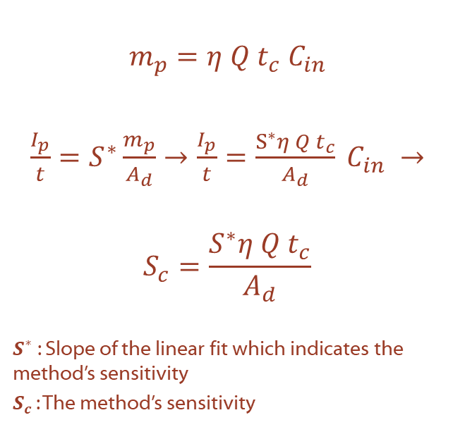
Raman Spectroscopy: Measurement Sensitivity
$$m_{p}=η{ Q t_{c} C}_{in}$$
$\frac{I_{p}}{t}=S^{∗}\frac{m_{p}}{A_{d}}→\frac{I_{p}}{t}=\frac{S^{∗}η Q t_{c}}{A_{d}} C_{in} →$
$$S_{c}=\frac{S^{∗}η Q t_{c}}{A_{d}}$$
$S^{∗}$: Slope of the linear fit which indicates the method’s sensitivity
$S_{c}$ : The method’s sensitivity
Table 2 Operating parameters of several collection techniques for calculation of the collection methods’ sensitivity
Collection method | Collection Efficiency (η) | Q (L min⁻¹) | D₉₀ (mm)
Nano-spot Collector | 0.96 | 1.2 | 0.7
Spot Sampler | 0.95 | 1.0-1.5 | 1.0
Aerodynamic Lenses⁽²⁻⁴⁾ | 0.3-1.0 | 0.108 | 0.37-22.67
Filtration | 1.0 | 1.2 | 13
The collection time ($t_{c}$) used for the calculations was 1 minute.
Notes:
Raman spectroscopy was also used for plotting calibration curves of Raman Intensity in function with particulate mass collected on an SEM stub, using silica as aerosol of interest. Two calibration curves were extracted for two different initiator temperatures. The slopes of the linear curves are an indicator of the collection’s method sensitivity. At initiator temperature of 45 degrees of Celsius, the collector’s sensitivity is approximately 1.7 times higher than at 40 degrees of Celsius.

Slide 13
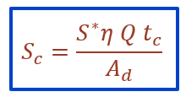
Raman Spectroscopy : Measurement Sensitivity
Figure 7 Sensitivity comparison of different collection techniques

Slide 14
Conclusions
Good particle collection attained down to sizes of a few nanometers, for soluble and insoluble aerosols, and for aerosol concentrations up to approximately 500,000 cm⁻³
Scanning Electron Microscopy was used for:
  Deposition diameter calculation (D₉₀= 0.7 mm)
Raman Spectroscopy was used for:
  Spot uniformity evaluation (uniformity is observed in a range of ± 0.2 mm around the center of the spot)
  Mass calibration curve extraction
  Measurement sensitivity comparison with other conventional collection techniques (Nano-spot Collector exhibits the highest collection sensitivity)
Improvements to tighten the deposition area for even more uniform deposits are planned for the future.
Notes:
That concludes my presentation. However, I’d like to quickly summarize the main points of this research. First, we can attain complete particle collection down to sizes of a few nanometers. Additionally, excellent collection efficiency can be achieved in aerosol concentrations up to 500,000 pcs per ccm. Also, a tight deposition area was formed, with an approximately 0.7 mm diameter, for all particle sizes. Moreover, the Nano-spot collector was effectively coupled with Raman spectroscopy, and Raman was also used to verify the deposition area uniformity. Finally, improvements to tighten the deposition area for even more uniform deposits are planned for the future.

Slide 15
References
1. Zervaki, O.; Stump, B.; Keady, P.; Kulkarni, P.; Dionysiou, D. D. Design and Characterization of Triple-Tube, Laminar-Flow Condensation Nano Spot-Collector: Application to Microscopy and Spectroscopic Analysis of Aerosols. In 39th AAAR Annual Conference; Virtual, 2021.
2. Aerosol Devices Inc. Sequential Spot Sampler https://aerosoldevices.com/products/sequential-spot-sampler/ (accessed Feb 14, 2022).
3. Wang, X.; McMurry, P. H. Instruction Manual for the Aerodynamic Lens Calculator. Aerosol Sci. Technol. 2006, 40 (5), 1–10. https://doi.org/10.1080/02786820600616764.
4. Wang, X.; McMurry, P. H. A Design Tool for Aerodynamic Lens Systems. Aerosol Sci. Technol. 2006, 40 (5), 320–334. https://doi.org/10.1080/02786820600615063.
5. Liu, P.; Ziemann, P. J.; Kittelson, D. B.; Mcmurry, P. H. Generating Particle Beams of Controlled Dimensions and Divergence : II . Experimental Evaluation of Particle Motion in Aerodynamic Lenses and Nozzle Expansions Generating Particle Beams of Controlled Dimensions and Divergence : 11 . Experimental Evaluatio. 1995, 6826. https://doi.org/10.1080/02786829408959749.
Notes:
That concludes my presentation. However, I’d like to quickly summarize the main points of this research. First, we can attain complete particle collection down to sizes of a few nanometers. Additionally, excellent collection efficiency can be achieved in aerosol concentrations up to 500,000 pcs per ccm. Also, a tight deposition area was formed, with an approximately 0.7 mm diameter, for all particle sizes. Moreover, the Nano-spot collector was effectively coupled with Raman spectroscopy, and Raman was also used to verify the deposition area uniformity. Finally, improvements to tighten the deposition area for even more uniform deposits are planned for the future.

Slide 16
Contact
Orthodoxia Zervaki
Department of Chemical and Environmental Engineering, University of Cincinnati, Cincinnati, OH, USA
Email: s.zervaki@gmail.com, zervakoa@mail.uc.edu
Phone:513-399-2134
National Institute of Occupational Health and Safety, CDC
Email: nvr7@cdc.gov
Phone: 513-458-7196
Notes:
And here you can see my contact information in case you want to contact me for questions regarding the presentation or the Nano-Spot collector. Thank you for watching my presentation.

